Slide 1
Introduction to Machine Learning and Analytics on Simulated EMR Data
MLADS, November 2022
Robert Horton, PhD
rhorton@microsoft.com
Maryam Tavakoli Hosseinabadi, PhD Maryam.Tavakoli@microsoft.com
Mario Inchiosa, PhD
marinch@microsoft.com
https://github.com/rmhorton/EMR-data-science

Slide 2
Objectives
EITHER
Learn basic concepts and skills for ML and analytics
OR
Evaluate this material for use in your own teaching
We focus on techniques useful for sanity checking data and results.
Notes:
We assume most attendees are probably somewhere on this spectrum between student and teacher.
Clinicians in medical informatics don't necessarily need to become full-time data scientists, but they do need to provide oversight and sanity checking.

Slide 3
Machine Learning
Machine Learning is mostly about finding statistical relationships among attributes in past data ("training data") that help us make useful predictions about future data.
But data can be wrong in the sense that it may contain biased or incorrect relationships that will not generalize to the data we want to predict.
This workshop is mostly about how to do "sanity checking" of medical records data so that medical experts can judge whether the data seems reasonable. It is dangerous to do ML without analysis.

Slide 4
Technology
Exercises
Spark
analytics engine
large-scale data processing
Databricks
notebooks
collaboration
Languages
SQL
Python
R
Open-source
GitHub
Synthea
1_Synthea_exploration
counts/frequency distributions
subpopulations
distributions of conditions
(in)sanity checking
2_Synthea_cooccurrence
categorical 'items' (conditions, characteristics, medications, etc.) across encounters
item-pair statistics
co-occurrence graphs
3_Synthea_predict_breast_cancer
feature engineering
'too good to be true'
explainable model
performance (ROC curve)

Slide 5
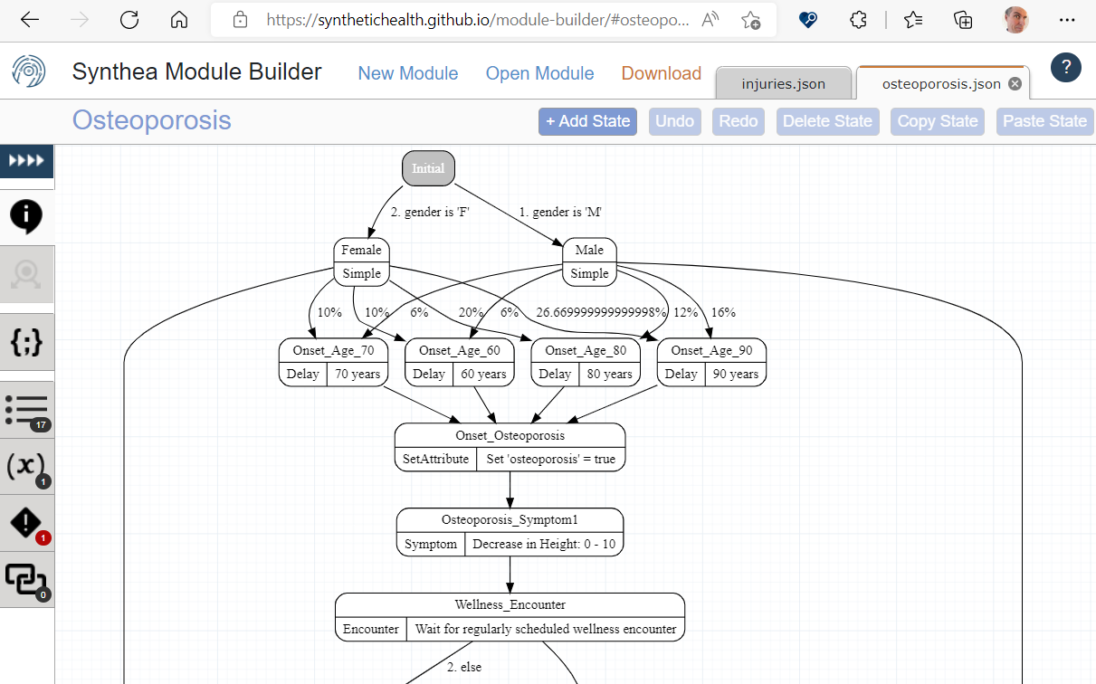
Synthea Patient Population Simulator
The schema of Synthea data is reasonably realistic, but the statistical relationships may be questionable.
Notes:
The data for today's workshop comes from an open source simulator called Synthea, which is a framework for simulating patients' lives. It incorporates a collection of well over a hundred modules that simulate the incidence, severity, treatment, and course of various conditions. The framework itself is a command-line program (not much to show on a slide), but the modules are authored as probabilistic flowcharts in the graphical "Module Builder" tool (shown here). Module authors are expected to be domain experts, not coding experts; the framework provides a collaborative platform where module authors can contribute to a common simulation.

Slide 6
Part 0: Setting up Databricks

Slide 7
Apache Spark & Microsoft Azure Databricks
Azure Cloud
Worker Node
Worker Node
Executor
Cache
Worker Node
Driver Node
Executor
Cache
Task
Task
Cluster Manager
Executor
Cache
SQL, Python, R
Task
Task
Task
Task
Distributed Compute
Distributed Storage
Notes:
Apache Spark is open-source software for processing large quantities of data.
Azure Databricks is built upon and enhances Apache Spark.
Azure Databricks is easy to use, integrated with Azure, and up to 50x faster than open-source Apache Spark.
Spark supports multiple languages, including SQL, Python, and R.
SQL queries are distributed across worker nodes, allowing you to analyze large amounts of data.
Many queries return a dataset of interest that is small enough to work with on a single computer (e.g. to find all the people with some rare disease, you have to look through a large number of records to find them, but there are not that many people with the disease.).

Slide 8
Part 1: Exploring the database

Slide 9
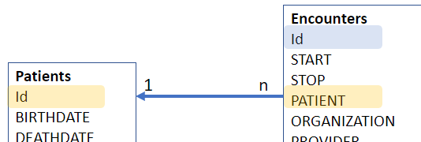
Relational Database
Store a system/org data by finding its Entity Types:
E.g., Patients, Encounters, Medications, ...
Express Entity Type with a Table – row (record) x column (attribute)
Primary key (PK) – One column that is record's identity [Patient-ID]
Link ("join") entities together by expressing a Relationship.
Relationship – By accepting a foreign key!
(Commonly) 1-to-many:
one Patient has many Encounters
one Encounter belongs to only one Patient!
Notes:
Relational databases are well-stablished form of storing digital structured information, particularly in the EMR systems. In relational model, we design the database based on the “Entity Types” we need to store our data and the “Relationship” between those entity types.
Some Entity Types in Electronic Medical Records could be “Patient”, “Encounter”, “Medication”, ..
Then, each Entity is translated into a Table form, i.e., rows x columns. Each row defines a new record/example of the entity, e.g., a new patient, and columns show the “Attributes” of the entities.
Relationships between the Entities/Tables are defined with the help of a type of attribute, called Primary Keys. Primary key, is typically one column in the table that is unique for each record. For example, patient-id (it can be very similar to patient MRN).
One-to-Many Relationship: Most of the relationship in the database are one-to-many; an example is Patient and Encounter. One patient can have many encounters, but an encounter belongs only to one patient. In order to reflect this on the database, we store the Patient-PrimaryKey (Patient-PK) into the Encounter Table. This will show each encounter record belongs to which patient. The column that stores patient primary key in the Encounter table is called ForeignKey.

Slide 10
Entity-Relation Diagram (ERD):
entities, attributes & relationships
Conditions
START
STOP
PATIENT
ENCOUNTER
CODE
DESCRIPTION
Encounters
Id
START
STOP
PATIENT
ORGANIZATION
PROVIDER
PAYER
ENCOUNTERCLASS
CODE
DESCRIPTION
BASE_ENCOUNTER_COST
TOTAL_CLAIM_COST
PAYER_COVERAGE
REASONCODE
REASONDESCRIPTION
1 n
Patients
Id
BIRTHDATE
DEATHDATE
…
FIRST
LAST
SUFFIX
MAIDEN
MARITAL
RACE
ETHNICITY
GENDER
…
1 n
Notes:
We express the Entities, their Attributes, and the Relationships in an Entity-Relation Diagram, called ERD. Relationships, and their cardinalities are shown similar to blue arrows, and you can see that the relationships are reflected by storing one table’s primary key into another table as a foreign key. For example, the 'id' column in the PATIENTS table is its primary key; this value is stored as a foreign key ('PATIENT') for Encounters associated with that patient. Similarly, the Encounter field in the Conditions table contains the id of a particular encounter.

Slide 11
Query: find what you want through Relation-Chains:
E.g., Find all encounters of patient John Smith for a “diabetes" condition:
SELECT e.* FROM Conditions AS c, Encounter AS e, Patient AS p
WHERE p.FIRST = 'John' AND p.LAST='Smith'
AND p.Id = e.PATIENT AND e.Id = c.ENCOUNTER
AND LOWER(c.DESCRIPTION) LIKE '%diabete%'
Conditions
START
STOP
PATIENT
ENCOUNTER
CODE
DESCRIPTION
1 n
Encounters
Id
START
STOP
PATIENT
ORGANIZATION
PROVIDER
PAYER
ENCOUNTERCLASS
CODE
DESCRIPTION
BASE_ENCOUNTER_COST
TOTAL_CLAIM_COST
PAYER_COVERAGE
REASONCODE
REASONDESCRIPTION
Patients
Id
BIRTHDATE
DEATHDATE
…
FIRST
LAST
SUFFIX
MAIDEN
MARITAL
RACE
ETHNICITY
GENDER
...
1 n
Notes:
We can then use the SQL-Queries to find the information we need using the entities, their attributes, and their relationship together. Here we want to find all the encounters of patient “John Smith” for a “covid” condition in the database. Therefore, we will need to:
Search for the record/s in table Patient, to find the one/s belong to “John Smith” => This gives us one or more Patient Id.
p.FIRST = 'John' AND p.LAST='Smith’
Then, search Encounters table to find Patient-ID from step 1 => This gives us a list of Encounters Id.
p.Id = e.PATIENT
Then, search Conditions that belong to either of the Encounters in step 2 => This gives us a list of conditions.
e.Id = c.ENCOUNTER
Then, display all the conditions from step 3 that has the word “diabete” in the Description:
- LOWER(c.DESCRIPTION) LIKE '%diabete%’
We call this Structured Query Language or SQL. More information on the syntax: SQL syntax - Wikipedia

Slide 12
Allergies
START
STOP
PATIENT
ENCOUNTER
CODE
SYSTEM
DESCRIPTION
TYPE
CATEGORY
REACTION1
DESCRIPTION1
SEVERITY1
REACTION2
DESCRIPTION2
SEVERITY2
Imaging_Studies
Id
DATE
PATIENT
ENCOUNTER
SERIES_UID
BODYSITE_CODE
BODYSITE_DESCRIPTION
MODALITY_CODE
MODALITY_DESCRIPTION
INSTANCE_UID
SOP_CODE
SOP_DESCRIPTION
PROCEDURE_CODE
Claims
Id
PATIENTID
PROVIDERID
PRIMARYPATIENTINSURANCEID
SECONDARYPATIENTINSURANCEID
DEPARTMENTID
PATIENTDEPARTMENTID
DIAGNOSIS1
DIAGNOSIS2
DIAGNOSIS3
DIAGNOSIS4
DIAGNOSIS5
DIAGNOSIS6
DIAGNOSIS7
DIAGNOSIS8
REFERRINGPROVIDERID
APPOINTMENTID
CURRENTILLNESSDATE
SERVICEDATE
SUPERVISINGPROVIDERID
STATUS1
STATUS2
STATUSP
OUTSTANDING1
OUTSTANDING2
OUTSTANDINGP
LASTBILLEDDATE1
LASTBILLEDDATE2
LASTBILLEDDATEP
HEALTHCARECLAIMTYPEID1
HEALTHCARECLAIMTYPEID2
EMR: All Synthea Entities
PK, FK, [ontology coding]
Patients
Id
BIRTHDATE
DEATHDATE
SSN
DRIVERS
PASSPORT
PREFIX
FIRST
LAST
SUFFIX
MAIDEN
MARITAL
RACE
ETHNICITY
GENDER
BIRTHPLACE
ADDRESS
CITY
STATE
COUNTY
ZIP
LAT
LON
HEALTHCARE_EXPENSES
HEALTHCARE_COVERAGE
Payer_Transitions
PATIENT
MEMBERID
START_YEAR
END_YEAR
PAYER
SECONDARY_PAYER
OWNERSHIP
OWNERNAME
Claims_Transactions
ID
CLAIMID
CHARGEID
PATIENTID
TYPE
AMOUNT
METHOD
FROMDATE
TODATE
PLACEOFSERVICE
PROCEDURECODE
MODIFIER1
MODIFIER2
DIAGNOSISREF1
DIAGNOSISREF2
DIAGNOSISREF3
DIAGNOSISREF4
UNITS
DEPARTMENTID
NOTES
UNITAMOUNT
TRANSFEROUTID
TRANSFERTYPE
PAYMENTS
ADJUSTMENTS
TRANSFERS
OUTSTANDING
APPOINTMENTID
LINENOTE
PATIENTINSURANCEID
FEESCHEDULEID
PROVIDERID
SUPERVISINGPROVIDERID
Payers
Id
NAME
ADDRESS
CITY
STATE_HEADQUARTERED
ZIP
PHONE
AMOUNT_COVERED
AMOUNT_UNCOVERED
REVENUE
COVERED_ENCOUNTERS
UNCOVERED_ENCOUNTERS
COVERED_MEDICATIONS
UNCOVERED_MEDICATIONS
COVERED_PROCEDURES
UNCOVERED_PROCEDURES
COVERED_IMMUNIZATIONS
UNCOVERED_IMMUNIZATIONS
UNIQUE_CUSTOMERS
QOLS_AVG
MEMBER_MONTHS
Organizations
Id
NAME
ADDRESS
CITY
STATE
ZIP
LAT
LON
PHONE
REVENUE
UTILIZATION
Encounters
Id
START
STOP
PATIENT
ORGANIZATION
PROVIDER
PAYER
ENCOUNTERCLASS
CODE
DESCRIPTION
BASE_ENCOUNTER_COST
TOTAL_CLAIM_COST
PAYER_COVERAGE
REASONCODE
REASONDESCRIPTION
Providers
Id
ORGANIZATION
NAME
GENDER
SPECIALITY
ADDRESS
CITY
STATE
ZIP
LAT
LON
UTILIZATION
Medications
START
STOP
PATIENT
PAYER
ENCOUNTER
CODE
DESCRIPTION
BASE_COST
PAYER_COVERAGE
DISPENSES
TOTALCOST
REASONCODE
REASONDESCRIPTION
Conditions
START
STOP
PATIENT
ENCOUNTER
CODE
DESCRIPTION
Procedures
START
STOP
PATIENT
ENCOUNTER
CODE
DESCRIPTION
BASE_COST
REASONCODE
REASONDESCRIPTION
Careplans
Id
START
STOP
PATIENT
ENCOUNTER
CODE
DESCRIPTION
REASONCODE
REASONDESCRIPTION
Observations
DATE
PATIENT
ENCOUNTER
CATEGORY
CODE
DESCRIPTION
VALUE
UNITS
TYPE
Devices
START
STOP
PATIENT
ENCOUNTER
CODE
DESCRIPTION
UDI
Supplies
DATE
PATIENT
ENCOUNTER
CODE
DESCRIPTION
QUANTITY
Immunizations
DATE
PATIENT
ENCOUNTER
CODE
DESCRIPTION
BASE_COST
Notes:
In this slide, we can see all the Entities in Synthea. The Yellow attributes are primary keys in each table and the blue ones are the foreign keys for defining relationships between the tables. With this information, you can draw its ERD (Entity-Relationship Diagram). Note that some tables are fine without any primary key, as no other table is referring to them [they are the many-side of the relationships] -- e.g., Medication table.
Note that CODE columns (in green) usually map to standard clinical vocabularies or ontologies such as SNOMED or ICD10. These tables are "denormalized" in that the code descriptions are copied into the tables, so you don't need to look them up every time. The downside of this denormalization is that the description for a given code is repeated each time the code appears, and it is possible for multiple descriptions to be stored for a code.

Slide 13
Part 2: Co-occurrence

Slide 14
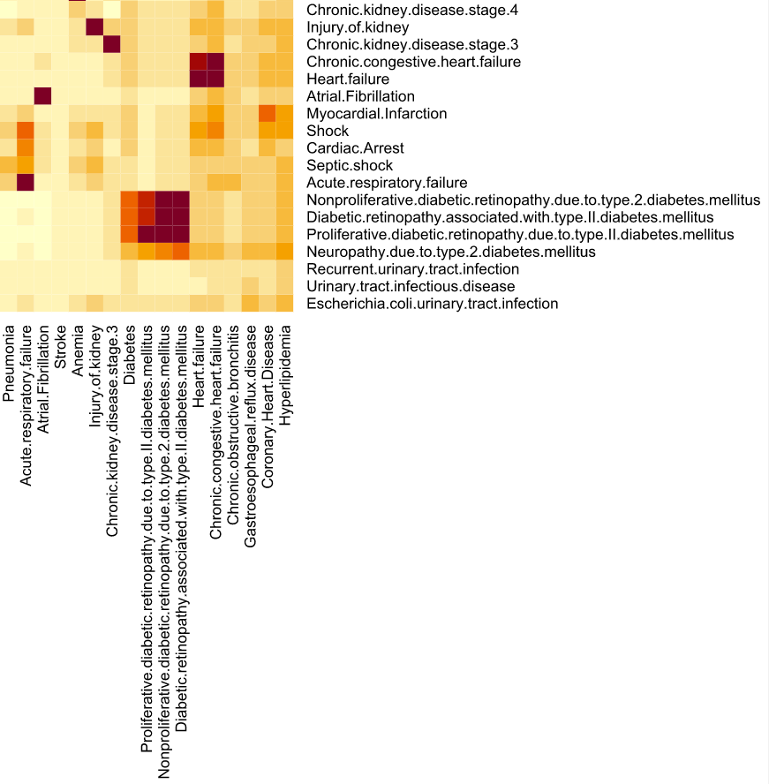
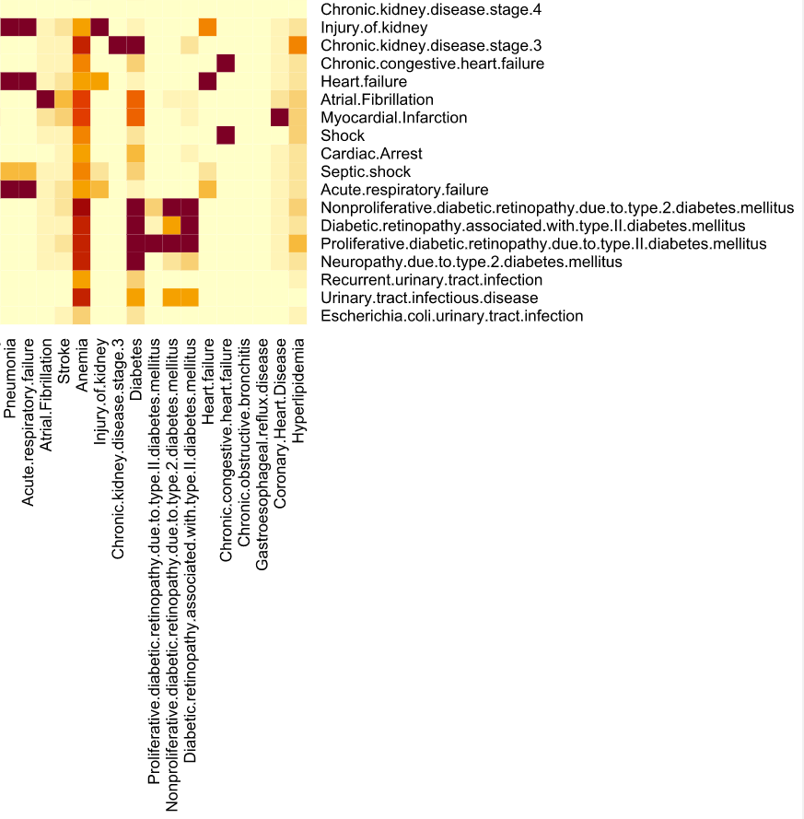
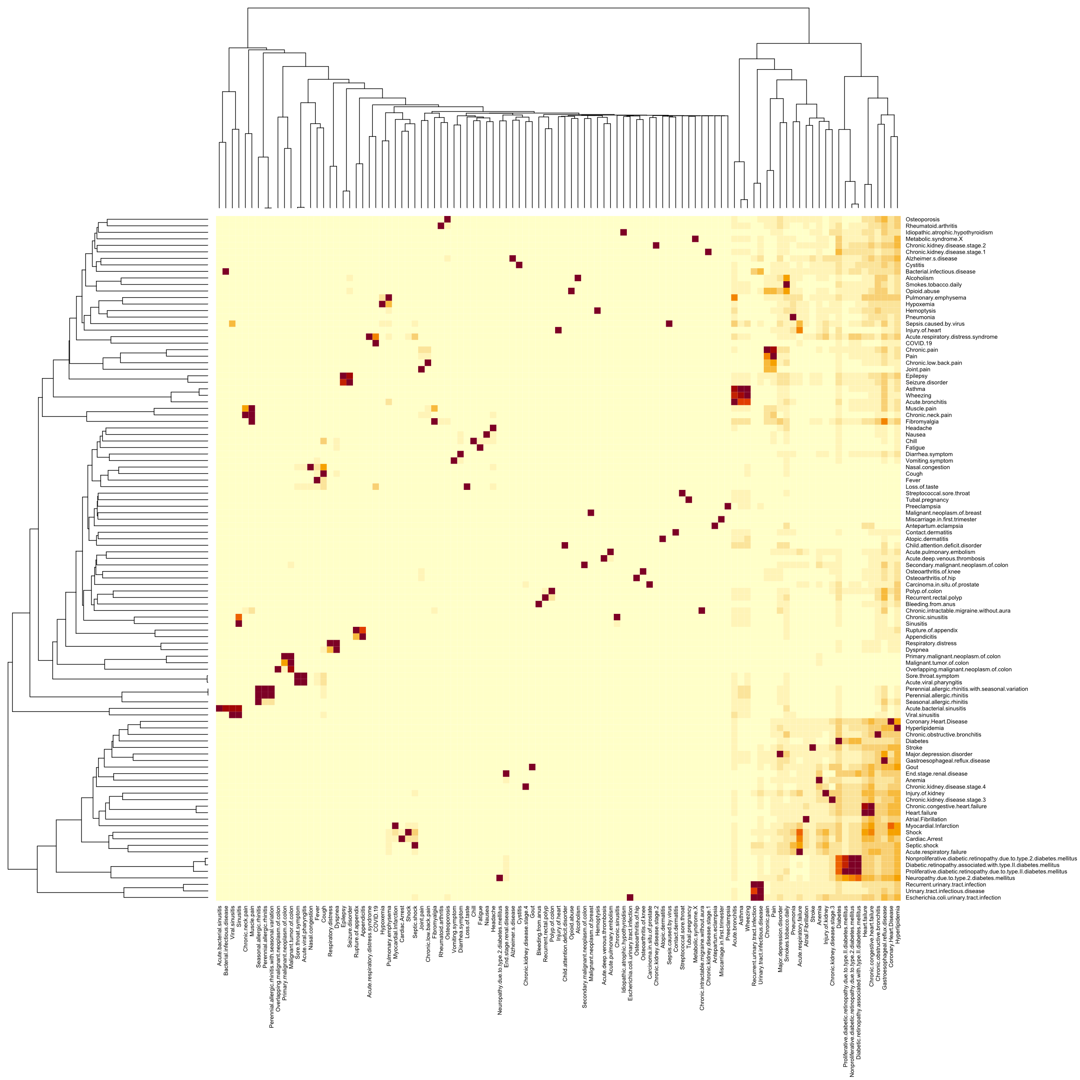
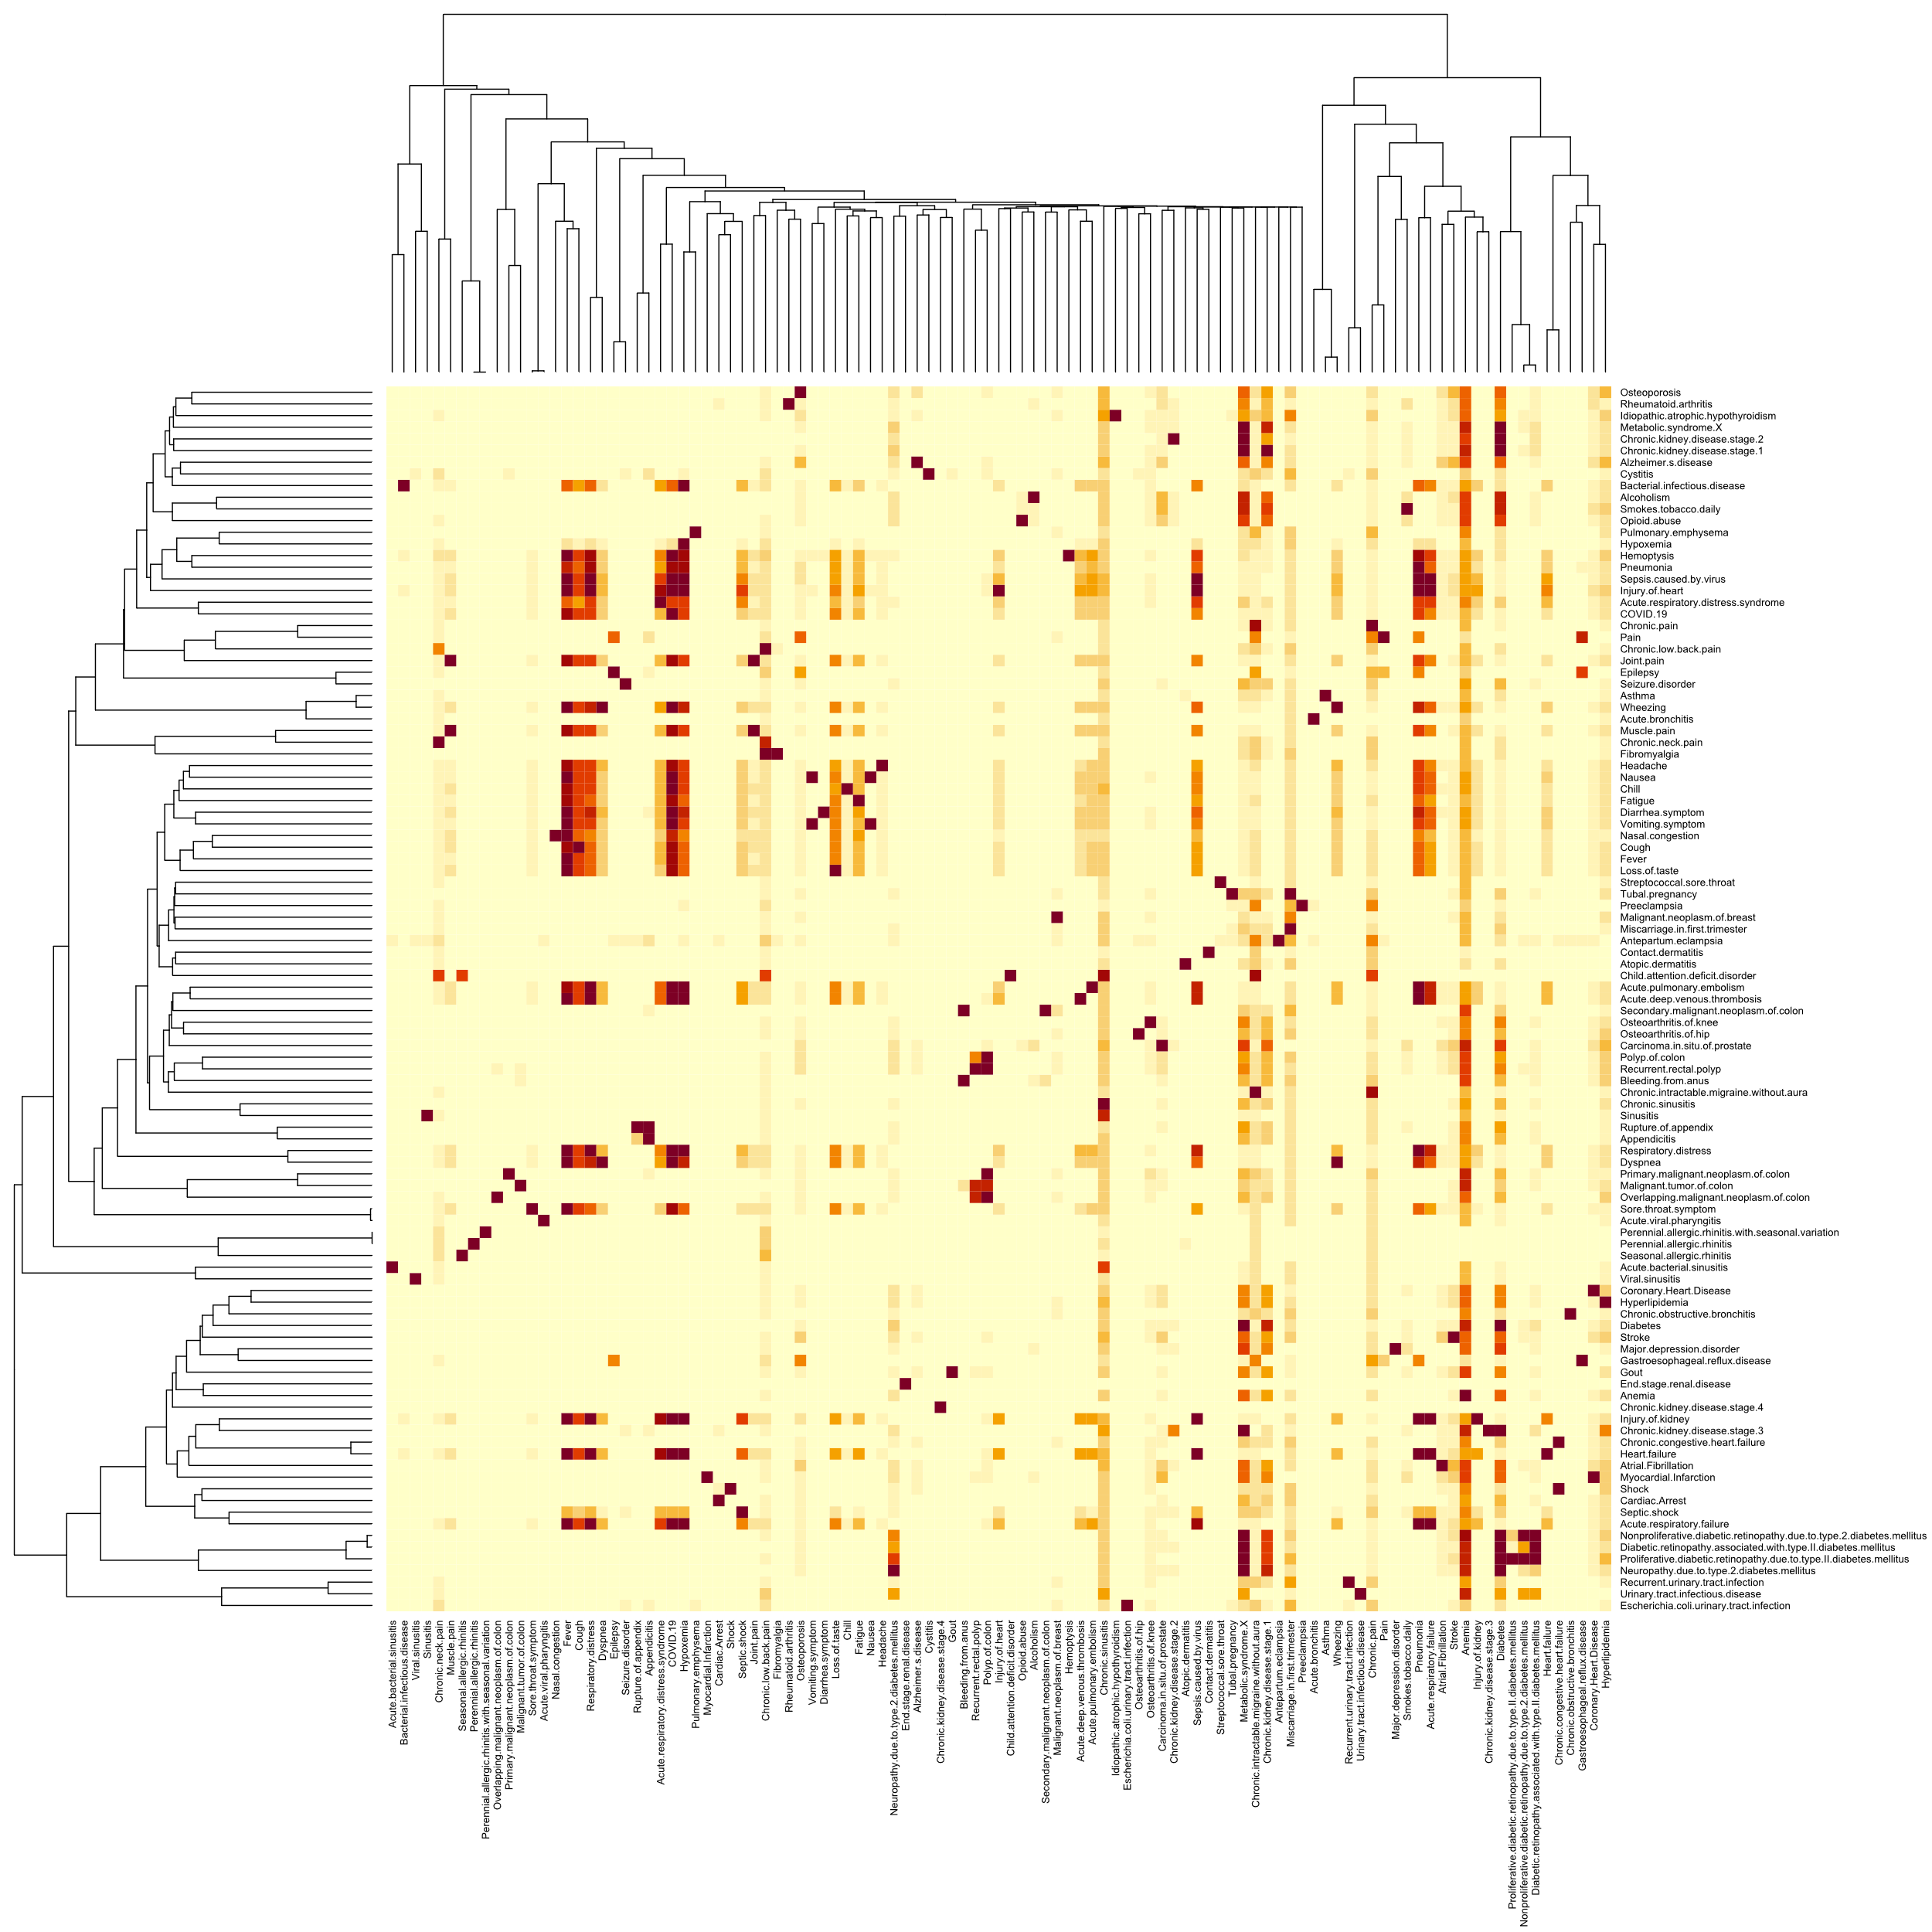
Co-occurrence
Underlies many ML techniques (e.g., recommendation)
Visualize patterns (or problems!) in the data
Matrix vs. graph
Real data
Simulated data
Notes:
These matrixes show how SNOMED concepts co-occur across encounters in real versus simulated data.
The rows and columns each represent a SNOMED concept. The cells in the matrix are the frequency of the patients with the condition of the row also having the condition of the column. This metric (which we call 'confidence') is asymmetrical; all patients with diabetic retinopathy also have diabetes, but not all patients with diabetes have retinopathy.
We start with a zoomed-in portion of the matrix, so you can read the row and column labels. Then we zoom out to the larger matrix so you can see the overall patterns.
The rows and columns have been clustered by similarity, so the order of terms in the rows is different from the order of the columns (if rows and columns were sorted in the same order, you would see a strong diagonal, since every item co-occurs with itself 100% of the time).
The simulated data differs from real data in (at least) two fundamental ways: a large number of weak associations are missing, and many of the associations that are present are far too strong.

Slide 15
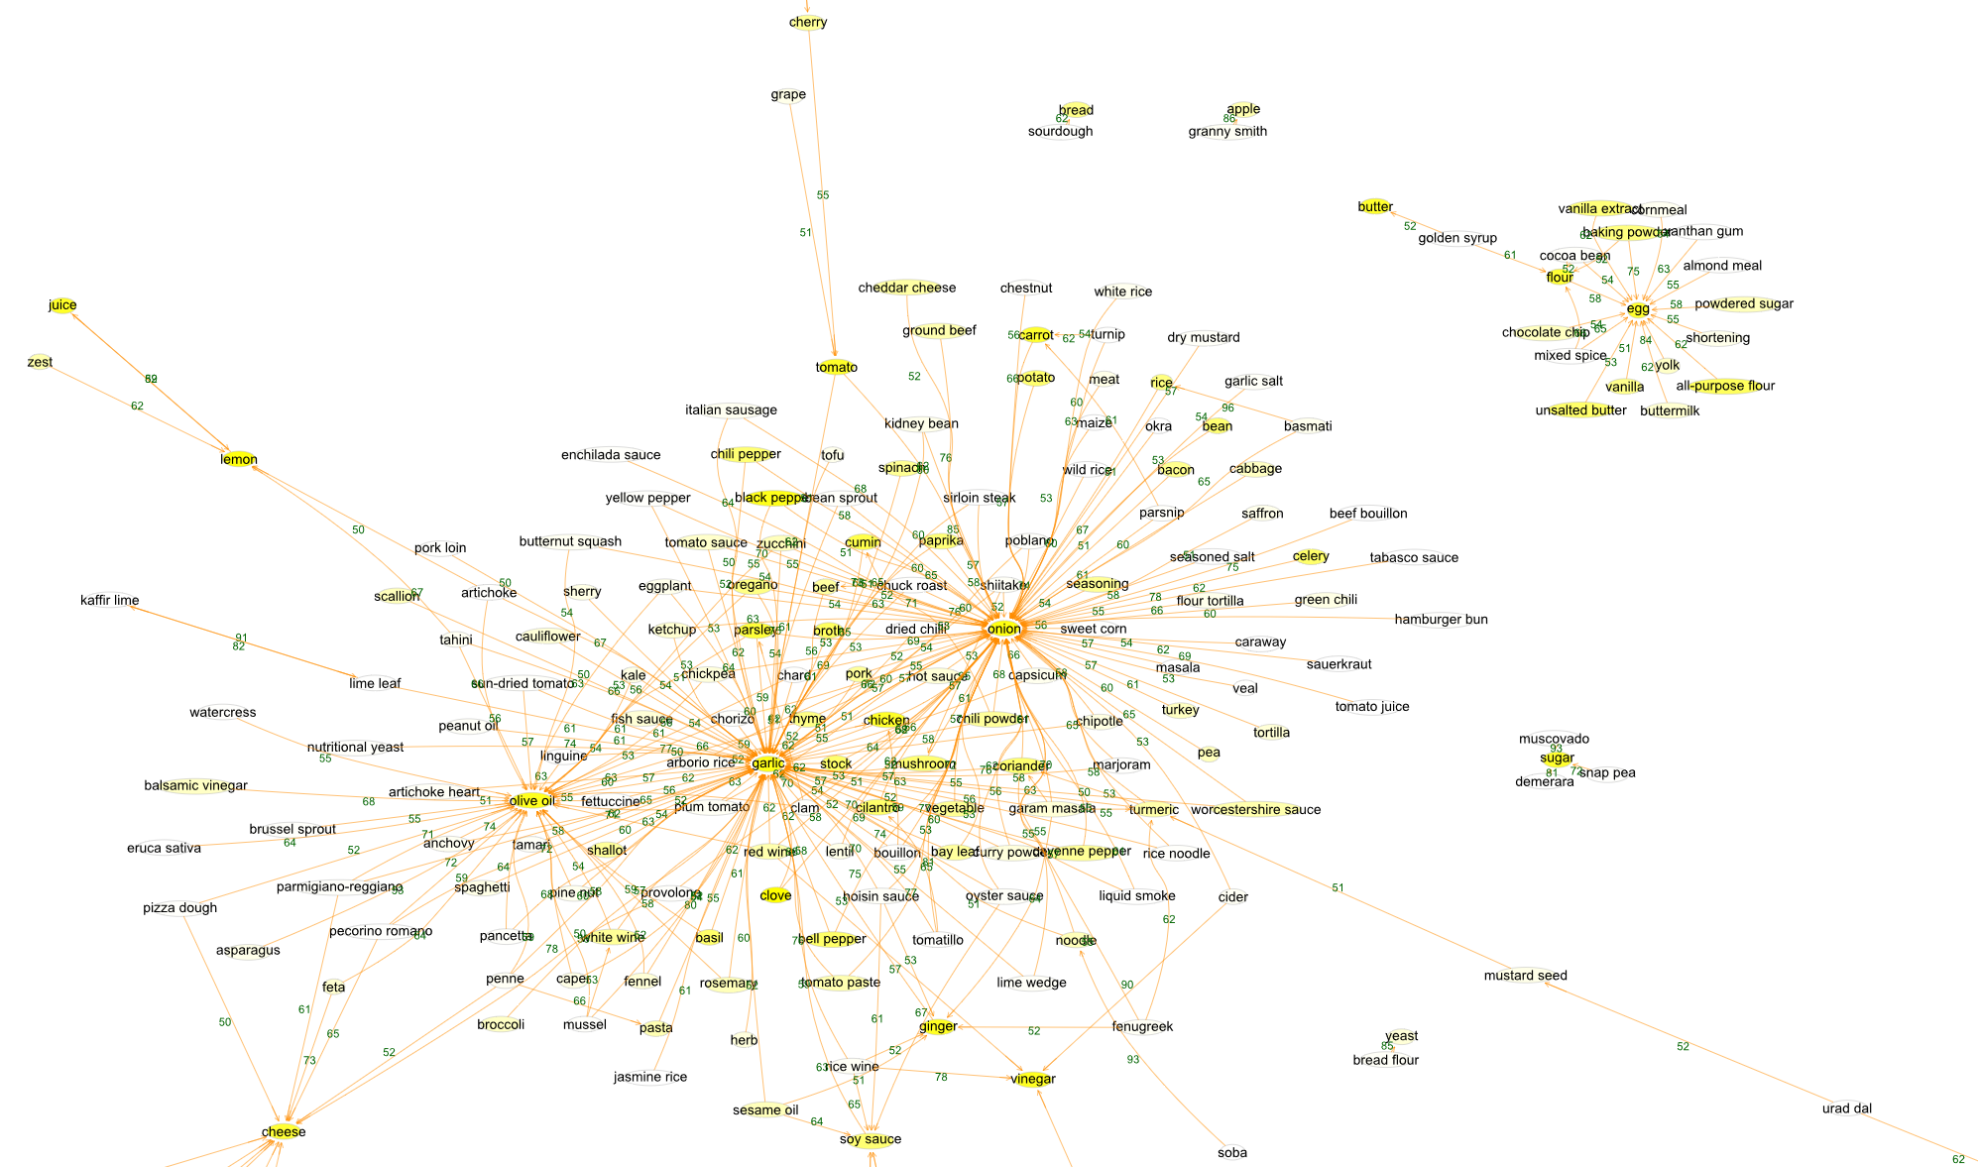
Notes:
This is an example of a co-occurrence graph. It shows ingredients mined from recipes on the web; we want to know how often each ingredient co-occurs with other ingredients, because we want to use this to make recommendations for new recipes people may want to try in the future, based on what they liked in the past. The nodes are ingredients, and the edges are 'confidence'. The graph has been filtered to show only the common ingredients and the high-confidence edges. The first thing you may notice is some general structure: ingredients like sugar, flour, and unsalted butter appear in a small cluster around the 'egg' node: we think these represent baked goods. The larger "cooking" cluster shows some density around 'olive oil', 'garlic', and 'onion'. But on closer inspection things don't make as much sense: 'cherry' co-occurs with 'tomato', 'granny smith' co-occurs with 'apple', and so forth. These are parsing issues; the program that tried to scrape ingredients from the recipe web pages thought "cherry" and "tomato" were separate ingredients when it should have extracted "cherry tomato". Inspecting this graph showed us about two dozen such parsing errors.
We can use this kind of visualization for "debugging data"; if we mistake 'cherry tomato' for a combination of cherry and tomato, we might end up making some wild recommendations.
You can make co-occurrence graphs from many different kinds of data (In the workshop we'll build a similar graph for SNOMED codes, patient demographic categories, and medications.) You may have data that could be analyzed this way; if you have always thought graphs were cool and wished you had one of your own, this is a simple way to get one.

Slide 16
Part 3: Explainable Boosting Machines

Slide 17

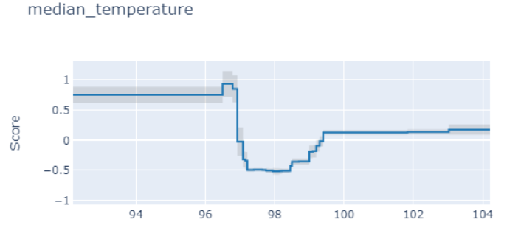
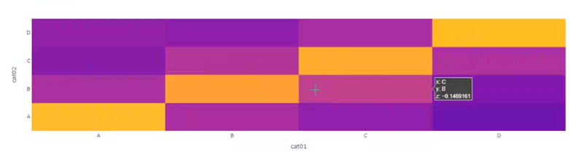
Explainable Boosting Machine (EBM): a fast implementation of GA²M Generalized Additive Model Plus Interactions
link function
expected outcome
functions of individual features
'heatmaps' of
interacting feature pairs
constant
Open-source implementation: https://interpret.ml
"InterpretML: A Unified Framework for Machine Learning Interpretability" (H. Nori, S. Jenkins, P. Koch, and R. Caruana 2019)
Notes:
Glass-box models are models that are interpretable due to their structure. Examples include linear models, rule lists, generalized additive models, and GA²Ms (EBMs).
EBMs rival the prediction abilities of the best full-complexity models such as random forests and gradient boosting machines, while being highly interpretable.
An EBM model consists of a constant term, arbitrary functions of individual features, and functions of feature pairs.

Slide 18
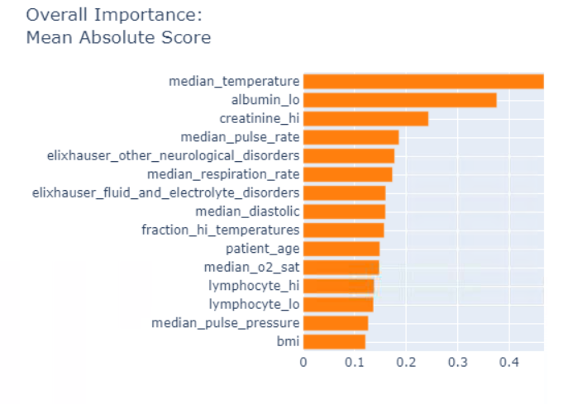
Interpreting an EBM Model
Use case: use COVID-19 patient data to predict the likelihood of ventilation within 72 hours
Notes:
EBM models are easy to interpret:
The EBM algorithm found median temperature to be the most important feature
Furthermore, EBM found that a temperature that is too low or too high predicts a higher likelihood of ventilation, while having a normal temperature lowers the predicted likelihood of ventilation.

Slide 19
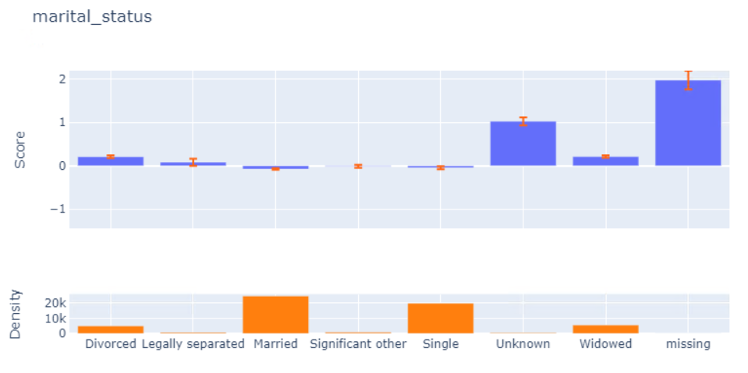
Missingness is meaningful
Notes:
EBMs can help us better understand our data.
The model shows that if marital_status is Unknown or missing, it tends to predict a higher chance of ventilation. This may be because patients in imminent need of ventilation coming into the ER are too sick to provide their marital status.

